Slide 1
Python Problem Solver

Slide 2
Get to know each other
I’m Bryan
Introduce each student:
Age / year
What have learned before?
What do you want to achieve?
What other hobbies do you have?
Write a name plate
Notes:
Introduce myself (5)
Introduce each student: (3 each)
Age / year
What have learned before?
What do you want to achieve?
What other hobbies do you have?
Write a name plate

Slide 3
Course objectives
Using Python to solve real life problems,
Building algorithmic thinking,
Data structures and algorithms,
Set foundation for high school Software Engineering, Enterprise Computing and related subjects,
Prepare for AIO and further competitions
John Von Neumann

Slide 4
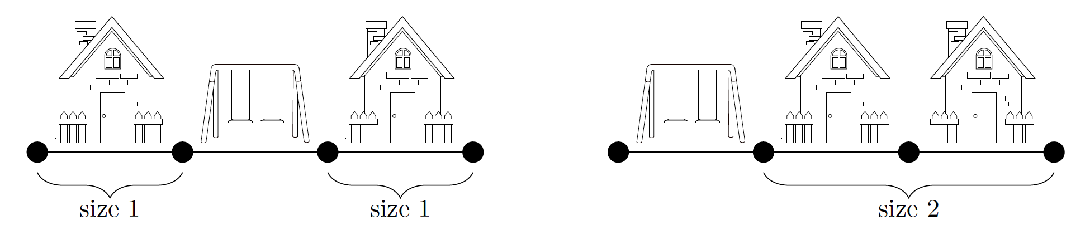
24 Street construction (2018 AIO P1)
The great city of Dubvegas is designing one side of a new street. This street is divided into evenly sized chunks of land, each of which will be used for either a house or a park. The city takes great pride in both the number of parks that it has, and that no one has to walk far to reach one of their wonderful parks.
In particular, the city calls a group of consecutive houses a ‘block’. The size of a block is the number of houses it contains.

Slide 5
24 Street construction (2018 AIO P1)
You must determine, given the number of chunks of land on the street and the number of parks that will be built, the minimum possible size of the largest block.
Input
The only line will contain the number of chunks of land N on the street, followed by the number of parks that will be built K.
Output
Your program should output the minimum possible size of the largest block on a street with N chunks of land, where K parks will be built.

Slide 6
24 Street construction (2018 AIO P1)
Sample Input 1 Sample Input 2 Sample Input 3
3 1 3 3 7 2
Sample Output 1 Sample Output 2 Sample Output 3
1 0 2

Slide 7
24 Street construction (2018 AIO P1)
Planning
Essentially it’s about how to divide the houses into blocks ‘as evenly as possible’.
Number of blocks is number of parks + 1
What’s the size of the largest block when distributed ‘as evenly as possible’?
If N is a multiple of K+1, it’s _______.
If not, it’s _______.
It’s indeed ceiling division. Useful formula for ceiling division a by b:
(a + b - 1) // b, or
1 + ((a - 1) // b)

Slide 8
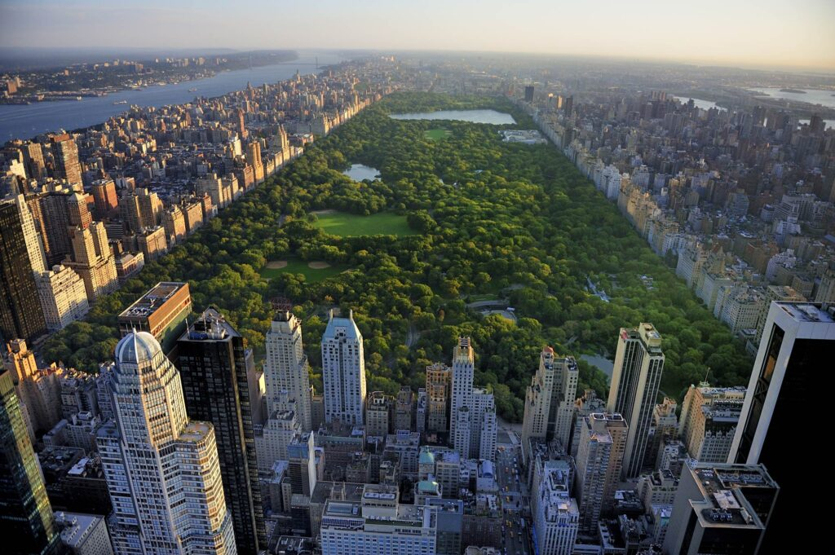
24 Street construction (2018 AIO P1)
Code explained

Slide 9
24 Street construction (2018 AIO P1)

Slide 10
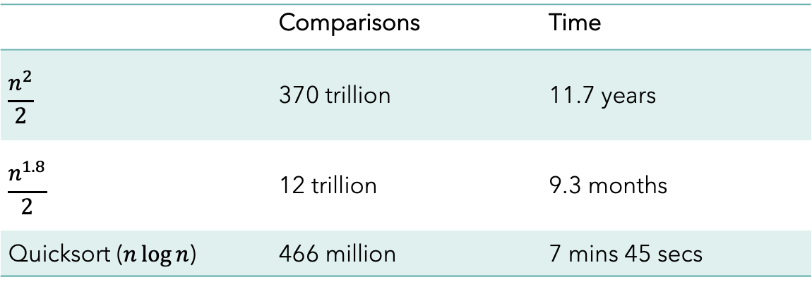
24 bubble sort
Almost all software systems will need to sort data in a particular order.
Problem: Sort 27.2 million data records, how long does it take?
 | Comparisons | Time
$$\frac{n^{2}}{2}$$ | 370 trillion | 11.7 years
$$\frac{n^{1.8}}{2}$$ | 12 trillion | 9.3 months
Quicksort ($n\log{n}$) | 466 million | 7 mins 45 secs

Slide 11
24 bubble sort
There are many different sorting algorithms, each with different space and time complexity, and different use cases.
The simplest is the bubble sort.
https://sortvisualizer.com/bubblesort/
You keep scanning the entire list from left to right, each time swapping a pair of adjacent numbers if they are not in order.
Now you see why it’s called bubble sort?

Slide 12
24 Bubble Sort
Plan (sort in ascending order):
Prepare the input list
Loop i from 1st to last:
Loop j from 1st to last:
if list[j] < list[j-1]:
swap list[j] with list[j-1]
Output list

Slide 13
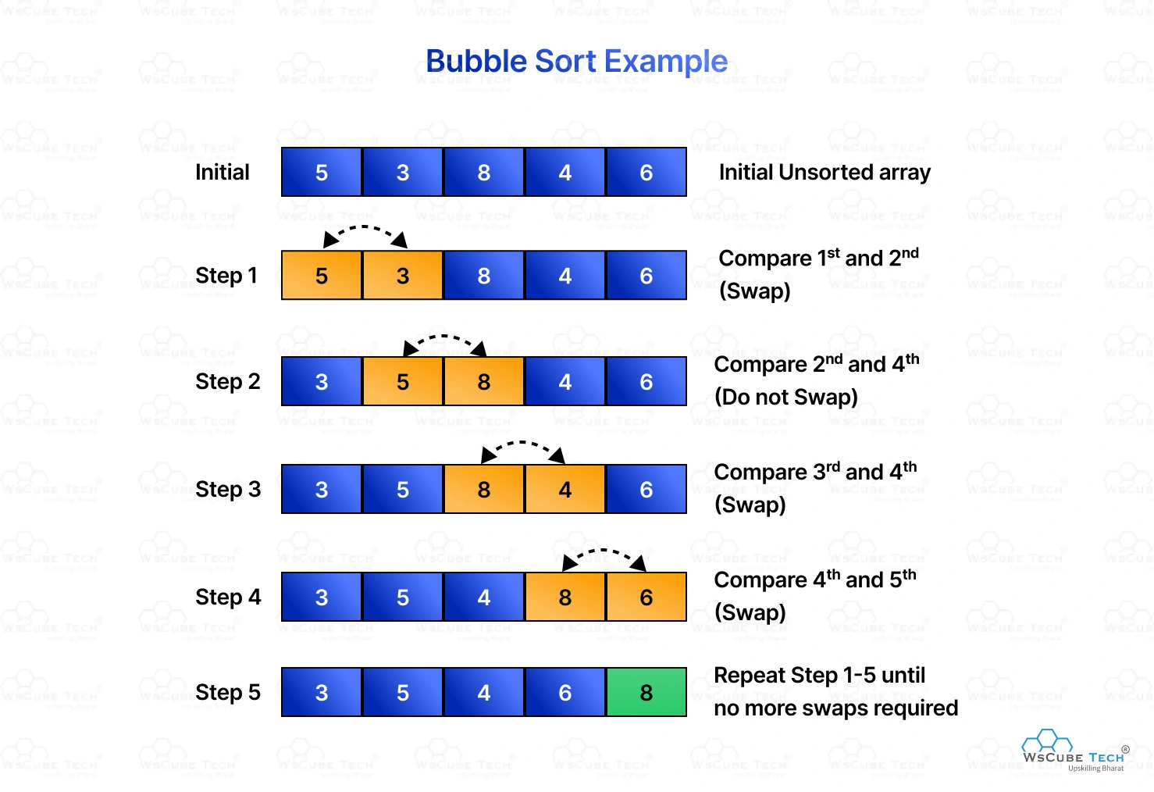
24 bubble sort
Code explained

Slide 14
23 The Vigenère Cipher
There are many different sorting algorithms, each with different space and time complexity, and different use cases.
The simplest is the bubble sort.
https://sortvisualizer.com/bubblesort/
You keep scanning the entire list from left to right, each time swapping a pair of adjacent numbers if they are not in order.
Now you see why it’s called bubble sort?

Slide 15
24 Bubble Sort
Plan (sort in ascending order):
Prepare the input list
Loop i from 1st to last:
Loop j from i+1 to last:
if list[j] < list[j-1]:
swap list[j] with list[j-1]
Output list

Slide 16
25 conway’s game of life
https://en.wikipedia.org/wiki/Conway%27s_Game_of_Life
It’s a zero-player game, meaning that its evolution is determined by its initial state, requiring no further input. You create an initial configuration and observe how it evolves.
The universe of the Game of Life is an infinite two-dimensional orthogonal grid of square cells, each of which is in one of two possible states, alive or dead, or “populated” or “unpopulated”. Every cell interacts with its eight neighbours.
At each step in time, the following transitions occur:
Any live cell with fewer than two live neighbours dies.
Any live cell with two or three live neighbours lives on to the next generation.
Any live cell with more than three live neighbours dies.
Any dead cell with exactly three live neighbours becomes a live cell.

Slide 17
25 conway’s game of life
The initial pattern constitutes the seed of the system. The first generation is created by applying the above rules simultaneously to every cell in the seed — births and deaths occur simultaneously.
The rules continue to be applied repeatedly to create further generations.
There are different seeds we can try. Or just random 15x15.
The Glider
The Toad
The Beacon
The Pulsar

Slide 18
25 conway’s game of life
Plan
Prepare the data structures for patters, example: Glider
def glider():
grid = []
grid.append([0,1,0,0,0,0,0,0,0,0])
grid.append([0,0,1,0,0,0,0,0,0,0])
grid.append([1,1,1,0,0,0,0,0,0,0])
grid.append([0,0,0,0,0,0,0,0,0,0])
grid.append([0,0,0,0,0,0,0,0,0,0])
grid.append([0,0,0,0,0,0,0,0,0,0])
grid.append([0,0,0,0,0,0,0,0,0,0])
grid.append([0,0,0,0,0,0,0,0,0,0])
grid.append([0,0,0,0,0,0,0,0,0,0])
grid.append([0,0,0,0,0,0,0,0,0,0])
return grid

Slide 19
25 conway’s game of life
Plan
Loop
Draw current grid
Update next grid using the rules
Swap current grid and next grid

Slide 20
25 conway’s game of life
Plan
How to draw grid?
First draw all the grid lines,
The loop through all rows then all column
if life != false, draw a box

Slide 21
25 conway’s game of life
#Draw the grid on screen (intDim is the width of a cell on the grid)
def drawGrid(grid, intDim):
global gridSize
#Clear the screen
myPen.clear()
for i in range(0, gridSize + 1):
myPen.penup()
myPen.goto(topLeft_x, topLeft_y - i * intDim)
myPen.pendown()
myPen.goto(topLeft_x + gridSize * intDim, topLeft_y – i * intDim)
for i in range(0,gridSize + 1):
myPen.penup()
myPen.goto(topLeft_x + i * intDim, topLeft_y)
myPen.pendown()
myPen.goto(topLeft_x + i * intDim, topLeft_y – gridSize * intDim)
for i in range(0,gridSize):
myPen.penup()
myPen.goto(topLeft_x + i * intDim + 10, topLeft_y + 10)
myPen.write(chr(65 + i))
for i in range(1, gridSize + 1):
myPen.penup()
myPen.goto(topLeft_x - 15, topLeft_y – i * intDim + 10)
myPen.write(str(i))

Slide 22
25 conway’s game of life
def drawGrid(grid,intDim):
…
myPen.setheading(0)
myPen.goto(topLeft_x, topLeft_y - intDim)
for row in range (0, gridSize):
for col in range (0, gridSize):
if grid[row][col] > 0:
box(intDim)
myPen.penup()
myPen.forward(intDim)
myPen.pendown()
myPen.setheading(270)
myPen.penup()
myPen.forward(intDim)
myPen.setheading(180)
myPen.forward(intDim * gridSize)
myPen.setheading(0)
myPen.pendown()

Slide 23
25 conway’s game of life
Plan
How to update next grid?
Loop for each row and each column
Calculate number of neighbours for current cell (how?)
Update next grid based on number

Slide 24
25 conway’s game of life
def checkCell(row, col, grid):
global gridSize
# We will count neighbours except when at the edge of the grid
minRow = 0
if row > 1:
minRow = row - 1
maxRow = gridSize - 1
if row < gridSize - 2:
maxRow = row + 1
minCol = 0
if col > 1:
minCol = col-1
maxCol = gridSize - 1
if col < gridSize - 2:
maxCol = col + 1
#Count the number of neighbours
neighbours = 0 - grid[row][col]
for nrow in range(minRow, maxRow + 1):
for ncol in range(minCol, maxCol + 1):
neighbours += grid[nrow][ncol]

Slide 25
25 conway’s game of life
def checkCell(row,col,grid):
…
# Apply the four key rules of Conway's Game of Life
# 1.Any live cell with fewer than two live neighbours dies, as if caused by underpopulation.
if grid[row][col] == 1 and neighbours < 2:
return 0
#2. Any live cell with two or three live neighbours lives on to the next generation.
elif grid[row][col] == 1 and (neighbours == 2 or neighbours == 3):
return 1
#3. Any live cell with more than three live neighbours dies, as if by overpopulation.
elif grid[row][col] == 1 and neighbours > 3:
return 0
#4. Any dead cell with exactly three live neighbours becomes a live cell, as if by reproduction.
elif grid[row][col] == 0 and neighbours == 3:
return 1
else:
return 0

Slide 26
25 conway’s game of life
Main program logic
Complete the program with other choices later
####################### MAIN PROGRAM STARTS HERE ######################
print("##########################")
print("Select a Starting Pattern:")
print(" 2: Glider")
choice = input("Your Choice (1-5)?")
if choice==”2":
gridSize = 10
currentgrid = glider()
else:
print("Invalid Choice!")
…

Slide 27
25 conway’s game of life
…
# Initialise the nextgrid
nextgrid = []
for row in range(0, gridSize):
nextgrid.append([])
for col in range(0, gridSize):
nextgrid[row].append(0)
#Start animating the grid
while True:
drawGrid(currentgrid, 25) #25 is the width of each square on the grid
myPen.getscreen().update()
time.sleep(0.5)
# Generate Next Grid using the four key rules of Conway's Game of Life
for row in range(0, gridSize):
for col in range(0, gridSize):
nextgrid[row][col] = checkCell(row, col, currentgrid)
# Swap grids (nextgrid becomes currentgrid)
tmpgrid = currentgrid
currentgrid = nextgrid
nextgrid = tmpgrid

Slide 28
25 conway’s game of life
Complete the main program:
#Conway's Game of Life
import turtle
import time
from random import randint
gridSize = 15
myPen = turtle.Turtle()
turtle.tracer(0)
myPen.speed(0)
myPen.color("#000000")
topLeft_x = -180
topLeft_y = 180
…

Slide 29
25 conway’s game of life
Draw the box (called by drawGrid())
# This function draws a box by drawing each side of the square and using the fill function
def box(intDim):
myPen.begin_fill()
# 0 deg.
myPen.forward(intDim)
myPen.left(90)
# 90 deg.
myPen.forward(intDim)
myPen.left(90)
# 180 deg.
myPen.forward(intDim)
myPen.left(90)
# 270 deg.
myPen.forward(intDim)
myPen.end_fill()
myPen.setheading(0)

Slide 30
25 conway’s game of life
…
# Initialise the nextgrid
nextgrid = []
for row in range(0, gridSize):
nextgrid.append([])
for col in range(0, gridSize):
nextgrid[row].append(0)
#Start animating the grid
while True:
drawGrid(currentgrid, 25) #25 is the width of each square on the grid
myPen.getscreen().update()
time.sleep(0.5)
# Generate Next Grid using the four key rules of Conway's Game of Life
for row in range(0, gridSize):
for col in range(0, gridSize):
nextgrid[row][col] = checkCell(row, col, currentgrid)
# Swap grids (nextgrid becomes currentgrid)
tmpgrid = currentgrid
currentgrid = nextgrid
nextgrid = tmpgrid

Slide 31
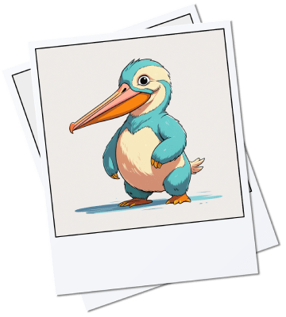
26 Naming New Species
After months of adventure on the mysterious island of Xylogora, you finally returned home. Your backpack is stuffed with notes, sketches, and a collection of breathtaking photos of creatures never seen before.
But you have a problem: Every great discovery needs a name, and you have dozens of new species waiting to be named and documented.
You decide to create a naming algorithm using string-handling techniques. The plan is simple yet ingenious: take the names of existing animals, rearrange their letters, or combine parts of their names to create unique ones. For instance, the “Wolphin” might come from “Wolf” and “Dolphin”.

Slide 32
26 Naming New Species
String Handling Techniques
To create the algorithm, you will need to use the following string handling techniques:
LEFT: to extract characters at the beginning of a string,
RIGHT: to extract characters at the end of a string,
SUBSTR or MID: to extract a set number of characters at a given position in a string,
LENGTH: to find out the number of characters in a string,
String Concatenation: to join two or more strings together.

Slide 33
26 Naming New Species
Your challenge:
Create these Python functions:
Take left() for an example:
Is this good enough?
What happens if string is empty?
What happens if number is zero or negative?
What happens there are not enough characters in string?
What happens…?
left(string, numberofcharacters)
right(string, numberofcharacters)
substr(string, start, numberofcharacters)
length(string)
concat(string1, string2)
def left(string, numberofcharacters):
return string[:numberofcharacters]

Slide 34
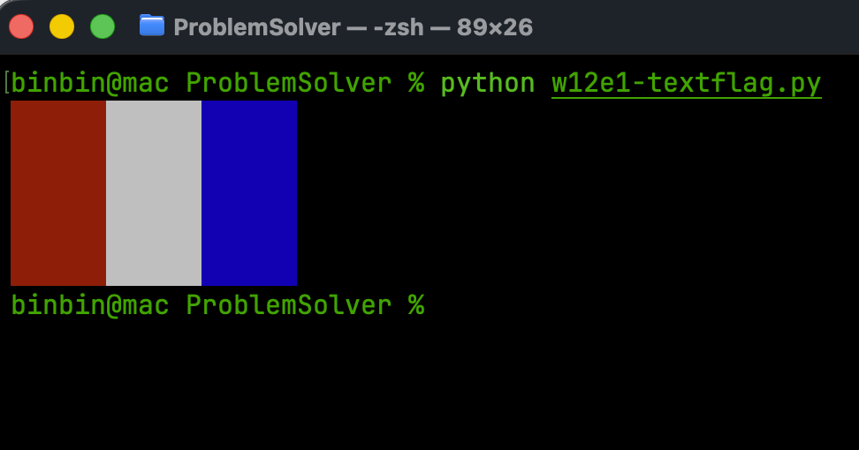
27 colourful texts
Ever got tired of the dull output screen?
What about this:

Slide 35
27 Colourful texts
First install the colorama package:
Then import init, Fore, Back and Style
$ pip install colorama
from colorama import init, Fore, Back, Style
# essential for Windows environment
init()
# all available foreground colours
FORES = [Fore.BLACK, Fore.RED, Fore.GREEN, Fore.YELLOW, Fore.BLUE, Fore.MAGENTA, Fore.CYAN, Fore.WHITE]
# all available background colours
BACKS = [Back.BLACK, Back.RED, Back.GREEN, Back.YELLOW, Back.BLUE, Back.MAGENTA, Back.CYAN, Back.WHITE]
# brightness values
BRIGHTNESS = [Style.DIM, Style.NORMAL, Style.BRIGHT]

Slide 36
27 Colour texts
Put the colours and styles in front of the contents you want to print:
Let’s make it reusable for other contents:
brightness = Style.DIM
colour = Fore.WHITE + Back.BLUE
print(f"{brightness}{colour}Hello, world{Style.RESET_ALL}")
def print_with_colour(s, colour=Fore.WHITE, brightness=Style.NORMAL, **kwargs):
"""Utility function wrapping the regular `print()` function
but with colours and brightness"""
print(f"{brightness}{colour}{s}{Style.RESET_ALL}", **kwargs)

Slide 37
27 colourful texts
Now let’s play:
And with the backgrounds:
# printing all available foreground colours with different brightness
for fore in FORES:
for brightness in BRIGHTNESS:
print_with_colour("Hello world!", colour=fore, brightness=brightness)
# printing all available foreground and background colours with different brightness
for fore in FORES:
for back in BACKS:
for brightness in BRIGHTNESS:
print_with_colour("A", colour=back+fore, brightness=brightness, end=' ')
print()

Slide 38
27 Colourful texts
Now let’s play:
Then import init, Fore, Back and Style
$ pip install colorama
from colorama import init, Fore, Back, Style
# essential for Windows environment
init()
# all available foreground colours
FORES = [Fore.BLACK, Fore.RED, Fore.GREEN, Fore.YELLOW, Fore.BLUE, Fore.MAGENTA, Fore.CYAN, Fore.WHITE]
# all available background colours
BACKS = [Back.BLACK, Back.RED, Back.GREEN, Back.YELLOW, Back.BLUE, Back.MAGENTA, Back.CYAN, Back.WHITE]
# brightness values
BRIGHTNESS = [Style.DIM, Style.NORMAL, Style.BRIGHT]

Slide 39
27 Colour texts
Put the colors and styles in front of the contents you want to print:
Let’s make it reusable for other contents:
brightness = Styles.DIM
colour = Fore.WHITE + Back.BLUE
print(f"{brightness}{colour}Hello, world{Style.RESET_ALL}")
def print_with_color(s, color=Fore.WHITE, brightness=Style.NORMAL, **kwargs):
"""Utility function wrapping the regular `print()` function
but with colors and brightness"""
print(f"{brightness}{color}{s}{Style.RESET_ALL}", **kwargs)

Slide 40
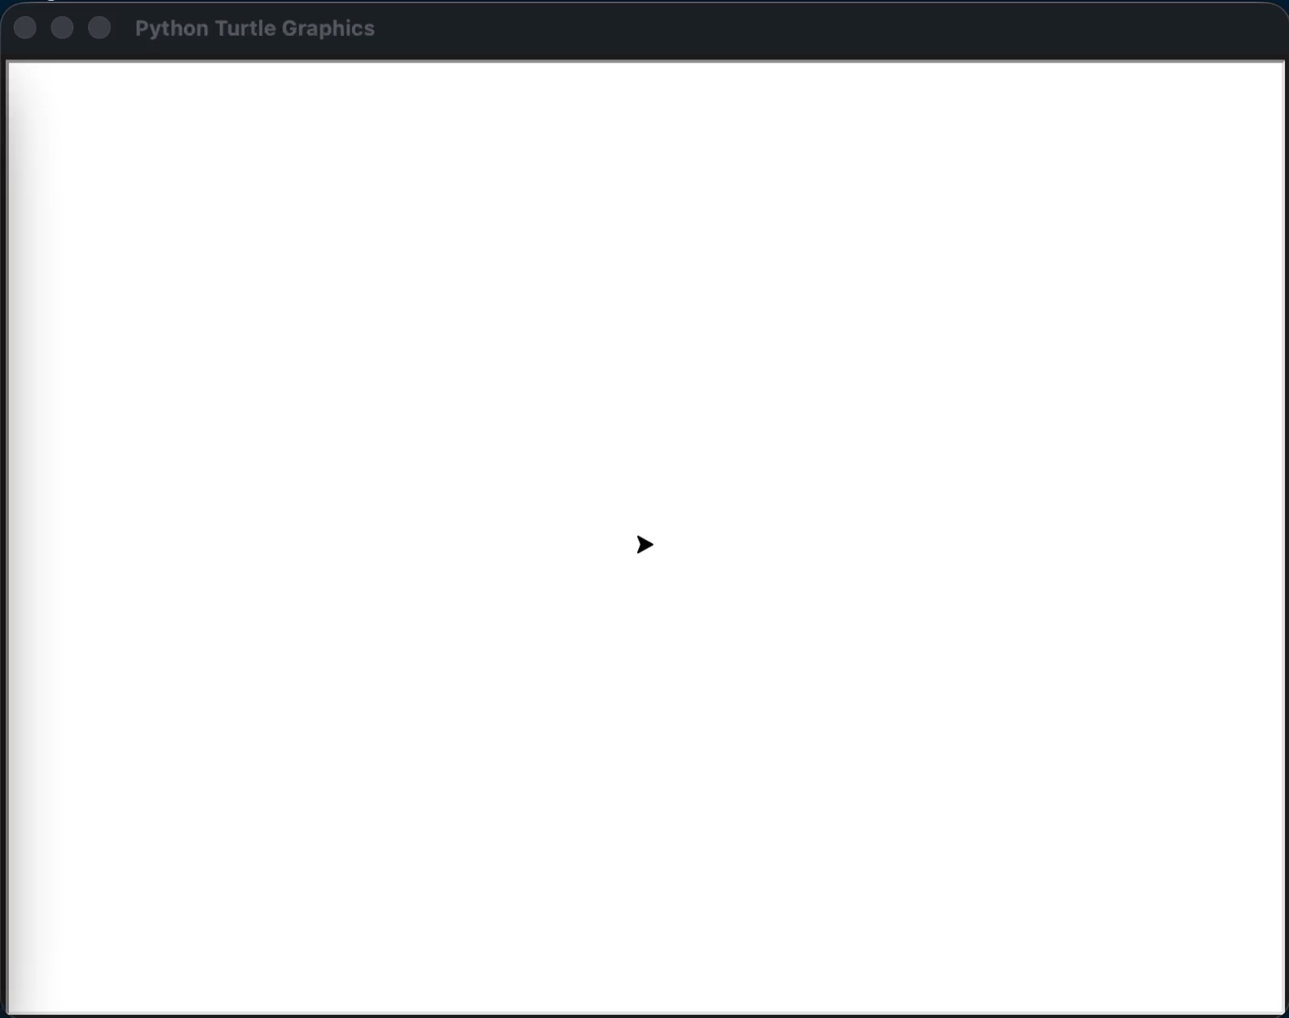

28 Circular maze
Let’s solve this maze on screen:

Slide 41
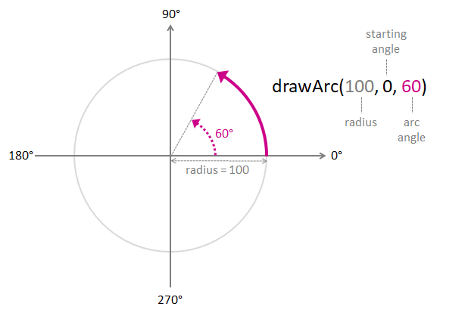
28 Circular maze
Apparently we need to draw an arc
Create a function called drawArc() that takes three parameters:
The radius of the arc (in pixels)
The starting angle of the arc (in degrees)
The angle of the arc (in degrees)

Slide 42
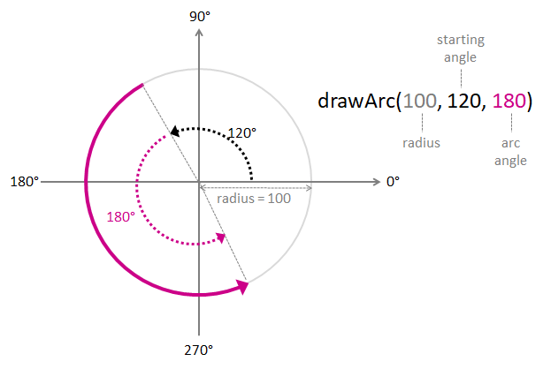
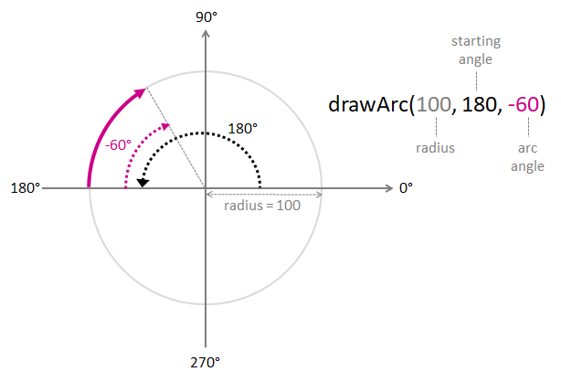
28 Circular Maze
And other kinds of arcs

Slide 43
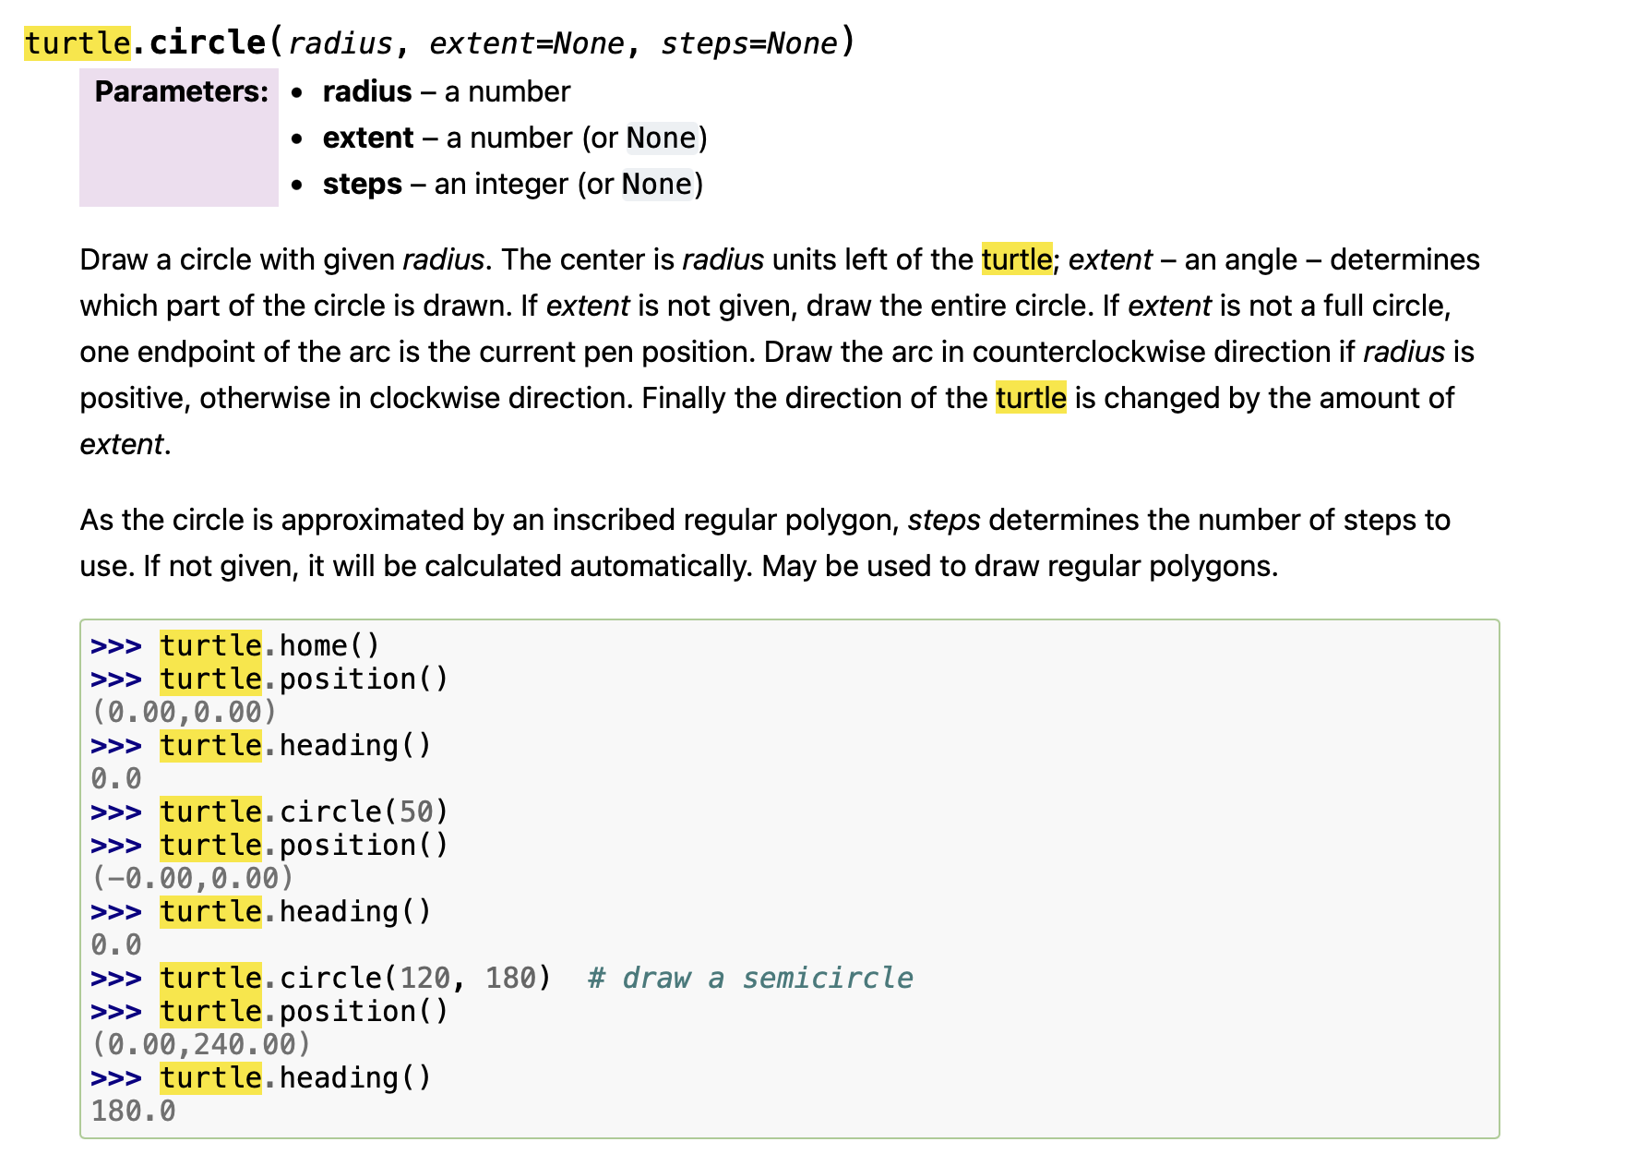
28 Circular maze
Use Python Turtle circle(radius, extent) function.
https://docs.python.org/3/library/turtle.html#module-turtle

Slide 44
28 Circular maze
import turtle
def drawArc(radius,startingAngle,angle):
myPen.setheading(startingAngle+90)
myPen.circle(radius,angle)
myPen = turtle.Turtle()
myPen.speed(100)
screen = turtle.Screen()
screen.setup(400, 400)
myPen.forward(25)
drawArc(165,175,-160)

Slide 45
28 Circular Maze
Then go ahead, keep trying to find all the angles and forward steps , and solve the maze.

Slide 46
29 Art Class II (2021 AIO P2)
You and your classmates were being a little too rowdy during art class this morning and have made a bit of a mess.
There’s a large, usually blank wall at the back of the classroom. Unfortunately, the class (mostly you, honestly) have made N holes in the wall. The i-th hole is located x_{i} centimetres from the left edge of the wall, and y_{i} centimetres from the bottom edge of the wall.
You and your class have decided to create a single large poster to put on the wall to cover the holes.
To be as inconspicuous as possible, your poster should be:
• rectangular in shape
• hung so its sides are parallel to the edges of the wall
• large enough to cover all of the holes

Slide 47
29 Art Class II (2021 AIO P2)
Note that a hole on the very edge of the poster will still be hidden (seems like your teacher forgot their glasses today).
You don’t have a lot of time before the teacher returns, so you’ve decided to write a program that will tell you the area of the smallest poster that will cover all the holes.
Input
• The first line of input contains the single integer N.
• The next N lines describe the location of the holes. The i-th line contains the two integers x_{i} and y_{i}.
Output
Your program should output a single integer, the area (in square centimetres) of the smallest poster that will cover all the holes.

Slide 48
29 Art Class II (2021 AIO P2)
2 ≤ N ≤ 100 000.
• 1 ≤ x_{i} ≤ 10 000, for all i.
• 1 ≤ y_{i} ≤ 10 000, for all i.
Sample Input 1 Sample Input 2 Sample Input 3
5 4 2
2 3 4 4 2 1
3 1 3 3 3 1
4 2 5 5
4 4 1 1
6 1
Sample Output 1 Sample Output 2 Sample Output 3
12 16 0

Slide 49
30 handling files and folders
Printing the Current Working Directory
Creating Directories
If you run this again, it will raise a FileExistsError, that's because the folder already exists. We can run os.mkdir() only if the folder doesn't exist:
os.path.isdir() function returns True if the pathname we passed refers to an existing directory.
import os
# print the current directory
print("The current directory:", os.getcwd())
# make an empty directory (folder)
os.mkdir("folder")
# running mkdir again with the same name raises FileExistsError, run this instead:
if not os.path.isdir("folder"):
os.mkdir("folder")

Slide 50
30 handling files and folders
Changing Directories
Then let’s print the working directory again:
# changing the current directory to 'folder'
os.chdir("folder")
# printing the current directory now
print("The current directory changing the directory to folder:", os.getcwd())

Slide 51
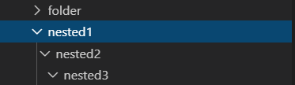
30 handling files and folders
Creating Nested Directories
These folders are created:
# go back a directory
os.chdir("..")
# make several nested directories
os.makedirs("nested1/nested2/nested3")

Slide 52
30 handling files and folders
Creating Files
Renaming Files
Moving Files
Note that this will overwrite the destination, so if there is another pre-existing file in "folder" that got the same name "renamed-text.txt", but different content, it will overwrite it.
# create a new text file
text_file = open("text.txt", "w")
# write to this file some text
text_file.write("This is a text file")
# rename text.txt to renamed-text.txt
os.rename("text.txt", "renamed-text.txt")
# replace (move) this file to another directory
os.replace("renamed-text.txt", "folder/renamed-text.txt")

Slide 53
30 handling files and folders
Listing Files and Directories
It returns a list containing the names of the files in the directory
But what if we want to know the content of these folders too?
os.walk() is a directory tree generator, it will iterate over all the directory trees
# print all files and folders in the current directory
print("All folders & files:", os.listdir())
# print all files & folders recursively
for dirpath, dirnames, filenames in os.walk("."):
# iterate over directories
for dirname in dirnames:
print("Directory:", os.path.join(dirpath, dirname))
# iterate over files
for filename in filenames:
print("File:", os.path.join(dirpath, filename))

Slide 54
30 handling files and folders
Deleting Files
Deleting Directories
Delete directories recursively
This will remove all these directories only if they're empty.
# delete that file
os.remove("folder/renamed-text.txt")
# remove the folder
os.rmdir("folder")
# remove nested folders
os.removedirs("nested1/nested2/nested3")

Slide 55
30 handling files and folders
To delete non-empty directories, use rmtree() from shutil
This operation can be quite dangerous. Take extra care.
# remote non-empty folders
shutil.rmtree("nested1")

Slide 56
30 handling files and folders
Retrieving Information About Files
This returns some metrics on it, some are interesting:
st_size: The size of the file in bytes.
st_atime: Time of most recent access expressed in seconds (timestamp).
st_mtime: Time of most recent modification.
st_ctime: In Windows, this is the time of the creation of the file, in Unix, this is the time of the most recent metadata change.
open("text.txt", "w").write("This is a text file")
# print some stats about the file
print(os.stat("text.txt"))
# get the file size for example
print("File size:", os.stat("text.txt").st_size)

Slide 57
30 handling files and folders
Deleting Files
Deleting Directories
Delete directories recursively
This will remove all these directories only if they're empty.
# delete that file
os.remove("folder/renamed-text.txt")
# remove the folder
os.rmdir("folder")
# remove nested folders
os.removedirs("nested1/nested2/nested3")

Slide 58

31 email address validator
Your program should decide whether the e-mail being entered is a valid one or not.
Some of the validation checks that your program should complete are as follows:
The email should contain one and only one “@” sign
The email should contain at least one “.” sign located after the “@” sign. However it may contains more than one “.” sign for emails ending in .co.uk for instance
The email cannot contain any space or “#” signs
The “@” sign cannot be in the first position and there should be at least 1 character between the “@” and the “.” sign.
The email cannot end with a “.” sign
.

Slide 59
31 Email address validator
Plan:
Input a string
Scan the string for ”@” signs and count them; break if invalid;
Scan the string for “.” sign before and after the “@” sign; break if invalid;
Scan the string for invalid characters; break if invalid;
Check “@” position and relative position with “.”; break if invalid;
Check ”.” position; break if invalid;
Confirm valid

Slide 60

31 Email address validator
Code explained

Slide 61
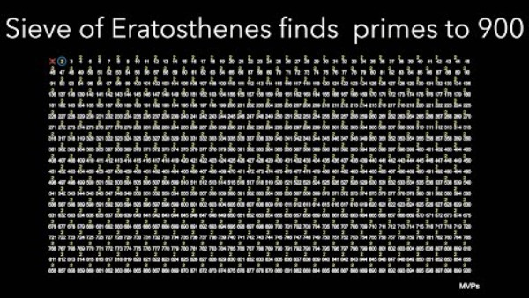
32 The Sieve of Eratosthenes
Do you know prime numbers? Do you remember how we find all the prime numbers?
There is an ancient but highly effective algorithm known as the Sieve of Eratosthenes, invented by Greek mathematician Eratosthenes (276 BC – 194BC).

Slide 62
32 The Sieve of Eratosthenes
Plan:
1. Create a List of Numbers: Start by listing all the numbers from 2 to the desired upper limit. For example, if we want to find all prime numbers up to 100, we would list the numbers from 2 to 100. Imagine that all these numbers are in a large sieve. Progressively, the non primary numbers will be removed as they will “pass through” the sieve (see steps 2, 3 and 4)!
2. Start with the First Number: The first number in the list is 2, which is a prime number. We will keep it (in our sieve) and eliminate all its multiples (i.e., 4, 6, 8, etc.) from the list because they are not prime.
3. Move to the Next Unmarked Number: The next unmarked number is 3, which is also a prime number. We’ll keep it and eliminate all its multiples (i.e., 6, 9, 12, etc.) from the list.
4. Repeat the Process: Continue this process with the next unmarked number, which is 5. Keep it and eliminate all its multiples. Repeat this process until you’ve gone through all the numbers in the list.
5. Identify the Prime Numbers: The numbers that remain unmarked in the list are prime numbers.

Slide 63
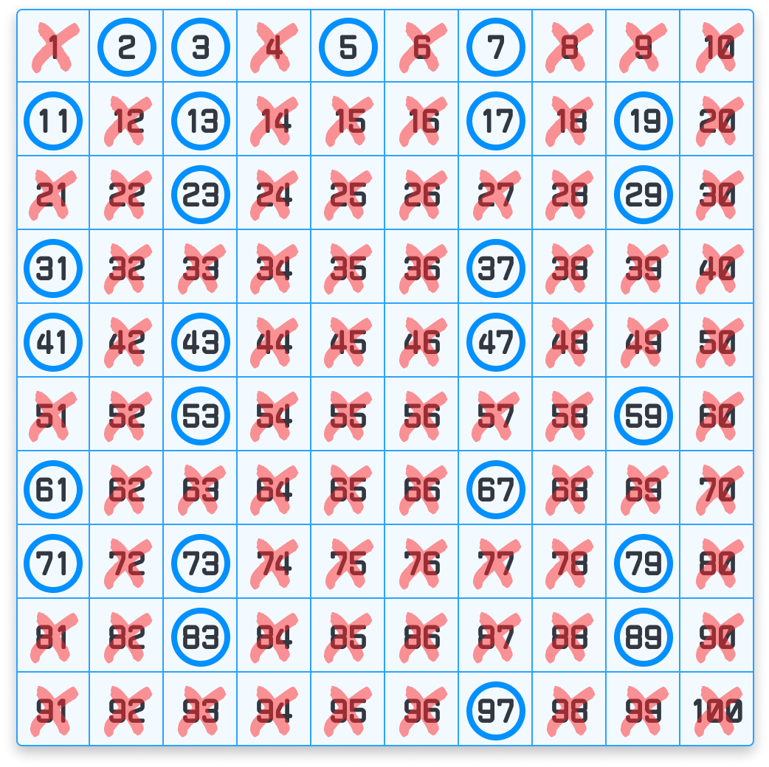
32 The Sieve of Eratosthenes
Code explained

Slide 64

33 Level Ground (2022 AIO P2)
The Australian Marathon Team is planning a race in the Great Dividing Range. The range is divided into N segments. The i-th segment has an altitude of A_{i} kilometres.
The race must take place over a single connected block of segments. Each segment of the race must have the same altitude.
Longer races and races at high altitude are more intense. The intensity of a race is the product of its length and altitude. For example, a race with 3 segments each with an altitude of 2 kilometres has an intensity of 3 × 2 = 6. What is the highest intensity that can be achieved?

Slide 65
33 Level Ground (2022 AIO P2)
Input
• The first line of input contains the integer N.
• The second line of input contains N integers describing the altitudes. The ith of these is Ai.
Output
Your program must output one integer: the highest intensity that can be achieved.
Sample Input 1 Sample Input 2 Sample Input 3
7 3 4
3 2 1 2 2 2 1 10 10 10 1 1 1 4
Sample Output 1 Sample Output 2 Sample Output 3
6 30 4

Slide 66
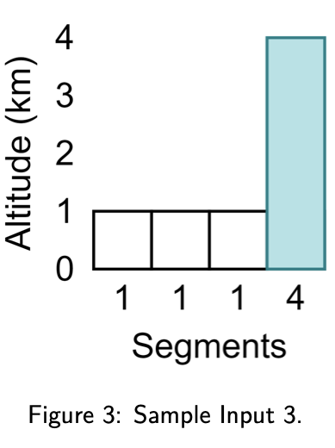
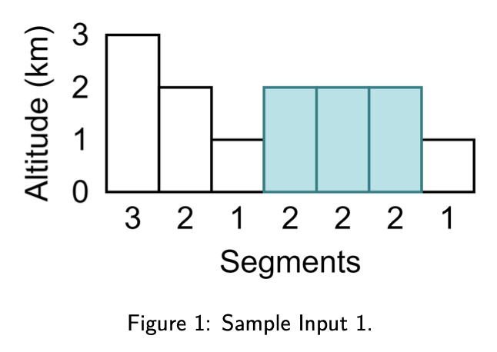
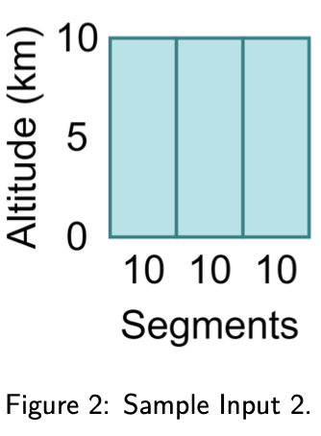
33 Level Ground (2022 AIO P2)
Explanations

Slide 67
33 Level Ground (2022 AIO P2)
Analyse
The problem is essentially asking, in a list of numbers, there are sublists (segments) of the same numbers. Note a single number can also be a segment. Among all those segments, find the one with the largest total.
Plan
Input the list
Loop through the list
When there’s height change, reset segment / intensity, otherwise increase intensity
Record max intensity so far
Output the final max intensity

Slide 68
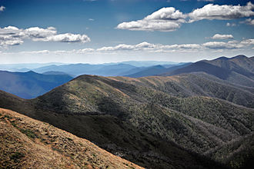
33 Level Ground (2022 AIO P2)
Code explained

Slide 69
33 Level Ground (2022 AIO P2)
Explanations

Slide 70
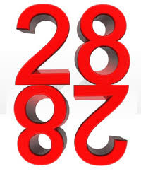
34 Reverse the digits
You are processing the data to train your Large Language Model. You invented a new algorithm which can reduce the training time and electricity consumption by 80%. One of the key steps is that you need to reverse the digits of each integer in the input data.
All integers are stored in a text file, which you will load into a list before processing.
Write a program to perform the reversing. Output the result for each of the integers in the list.

Slide 71
34 Reverse the digits
Analysis
How to get the lowest digit of an integer?
n % 10
How to iteratively get all the digits?
Code explained

Slide 72
34 Reverse the digits
Extension:
You got a new batch of data process by AI models from an alien planet which is in base-8.
Base-8 integers can have only 0 – 7 on each digit. A base-8 (or Octal) number 0221 is equal to 145 in base-10 (or decimal).
Write a program to take input which are base-8 representation of integers, and output the decimal representation.

Slide 73
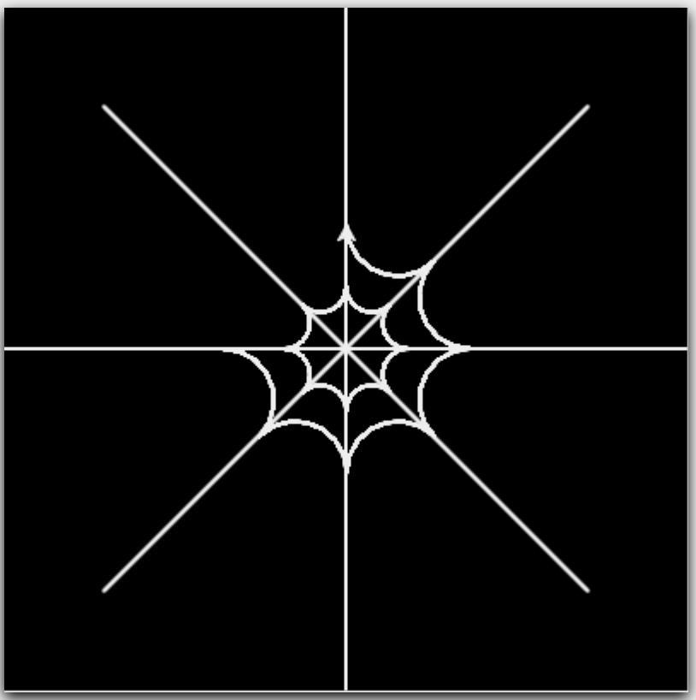
35 spider web
Plan
First draw the main threads, turn 45 degrees each time;
Then draw several layers of arc shapes
Remember we learned to draw arc?
def drawArc(radius,startingAngle,angle):
myPen.setheading(startingAngle+90)
myPen.circle(radius,angle)

Slide 74
35 Spider web
Starting angle: 90
L
22.5º
45º
L * tan(22.5º)
135º
drawArc(L * math.tan(math.pi/8), 90, -135)
angle: -135
drawArc(L * math.tan(math.pi/8), 90 + 45, -135)

Slide 75
35 spider web
import turtle, random
window = turtle.Screen()
window.bgcolor("#000000")
spider = turtle.Turtle()
spider.color("#EEEEEE")
spider.speed(0)
spider.pensize(2)
def drawSpiderWeb(layers):
for threads in range(8):
spider.forward(12*3*layers + 20)
spider.back(12*3*layers + 20)
spider.left(45)
spider.speed(1)
for i in range(1, layers+1):
spider.backward(12 * 3)
for j in range(8):
drawArc(5*3*i ,90 + j*45, -135)
spider.hideturtle()

Slide 76
Exercises

Slide 77
Week 10 problem 1
Street Construction Extension: Fountain Ring
The Epping Gardens are famous for their Great Circular Path. The path is divided into N evenly sized segments arranged in a circle, so segment 1 neighbours segment 2, segment 2 neighbours segment 3, and so on — and segment N neighbours segment 1again.
In each segment they will plant a hedge, except for K segments which will instead hold a drinking fountain. The gardeners announced that no one needs to walk any extra hedge even in the worst case, to get from one fountain to the next.
Given the number of segments N and the number of fountains K, find out that longest walk in terms of number of hedges.

Slide 78
Week 10 problem 2
Bubble Sort Extension: The other way round
On planet Bubble in the Alpha Centauri system, gravity is the other way round: it pushes things from the surface instead of pulls towards it.
Change your bubble sort program to sort the numbers in descending order, so that it can still be called ‘Bubble Sort’ on planet Bubble.

Slide 79
Week 10 Problem 3
Conway’s Game of Life Extension:
Implement the game.

Slide 80
Week 11 problem 1
Naming Species Extension: Name Blender
Write the function blend(name1, name2) that fuses two animal names into one, using only the functions we built in class. Use this split rule:
take the left half of name1 (round up), then
take the right half of name2 (round up), then concat() them.
blend("Wolf", "Dolphin") -> "Wophin"
blend("Koala", "Panther") -> "Koather"

Slide 81
Week 11 problem 2
Naming Species Extension 2 : Smart Blender
"Wophin" is fine, but the famous example is "Wolphin" — because "Wol" and "Dolphin" share the letter l at the seam. Write smart_blend(name1, name2) that:
searches for a split point where the last letter of the first fragment equals the first letter of the second fragment,
merges the two fragments on that shared letter (keeping only one copy),
falls back to plain blend if no such seam exists.
smart_blend("Wolf", "Dolphin") -> "Wolphin" # on shared 'l'
smart_blend("Cat", "Owl") -> falls back to blend()
This is a small search plus careful use of length() and substr().

Slide 82
Week 11 Problem 3
Conway’s Game of Life:
Complete the solution to allow user to choose among 5 options:
Glider, Toad, Beacon, Pulsar and random.

Slide 83
Week 12 problem 1
args Extension: Starburst
Draw a firework from the centre of the screen: one ray for each number you pass in, spread evenly around a full circle.
You will create a function
*lengths — any number of ray lengths. Six numbers → six rays, ten numbers → ten rays.
**style — optional look-and-feel with defaults: colour (default "black") and pensize (default 2).
Example use:
def burst(*lengths, **style):
...
burst(60, 100, 60, 140, 60, 100, colour="orange", pensize=3)

Slide 84
Week 12 problem 2
Naming Species Extension 3 : Codenames
It turns out that Xylogora was a secret base of MI7. They used you go discover new species, then they want you to turn a list of animal names into secret agency codenames — first three letters in caps, a dash, then how long the name is: "Dolphin" → "DOL-7".
Write a helper that codes one name, then use map() to apply it to the whole list. No for loop over the list, no list comprehension — map() does the looping.

Slide 85
Week 13 Problem 1
The Square Canvas:
You kids are naughty again, by splattering paint all over the floor.
The class has made N paint splatters on the floor. The i-th splatter is located xᵢ cms from the left edge of the floor, and yᵢ cms from the bottom edge.
Before the teacher gets back, you want to hide the evidence under a single canvas drop-sheet. Your canvas should be:
square in shape,
laid so its sides are parallel to the edges of the floor,
large enough to cover all of the splatters.
A splatter on the very edge of the canvas still counts as covered. You've decided to write a program that tells you the area of the smallest square canvas that will cover every splatter.

Slide 86
Week 13 problem 2
The Messy Expedition Folder
Back from Xylogora, you dumped every file into one folder, all mixed together. Time to tidy up automatically.
Your task. Write a function:
It looks at every file directly inside folder and moves it into a subfolder named after its extension. So kingfisher.jpg goes into a jpg/ subfolder, field_notes.txt into txt/, measurements.csv into csv/. Create each subfolder only if it doesn't already exist.
Example: A folder containing kingfisher.JPG, wolphin.jpg, field_notes.txt, measurements.csv, README becomes:
def organise_by_type(folder):
…
jpg/kingfisher.JPG jpg/wolphin.jpg
txt/field_notes.txt
csv/measurements.csv
no_extension/README

Slide 87
Week 14 problem 1
The Field Guide Census:
MI7 wants an inventory of your entire research archive — every folder, every subfolder, right to the bottom. You need a report, not just a listing.
Your task: Write a function:
It walks the whole directory tree under root and prints a summary: how many files there are in total, their combined size in bytes, and the path of the single biggest file.
Example output:
def census(root):
…
Files found : 5
Total size : 18 bytes
Biggest file: tree/photos/big.jpg (10 bytes)

Slide 88
Week 14 Problem 2
Email Validator Extension: Discount Vouchers
An online store gives customers discount voucher codes. Your program should decide whether a voucher code being entered is a valid one or not.
Some of the validation checks that your program should complete are as follows:
The code should contain one and only one "-" (hyphen) sign
The code should contain at least one digit (0–9) located after the "-" sign. However it may contain more than one digit for larger discount batches (e.g. SUMMER-2025)
The code cannot contain any space or "*" signs
The "-" sign cannot be in the first position and there should be at least 1 character between the start of the code and the "-" sign
The code cannot end with a "-" sign

Slide 89
Week 14 problem 3
Sieve Extension: The Stepping Stones
A line of stepping stones stretches across the pond, numbered 2, 3, 4, … up to N. Some stones are solid and safe to stand on; the rest are rotten and will sink. They all look the same, so the ranger gives you a rule to find the solid ones:
Look at the lowest stone you haven't checked yet — it's solid, so mark it safe. Then every stone whose number is a multiple of it (double, triple, quadruple, …) is rotten. Watch them sink. Move to the next stone still floating and do the same again.
You keep going until every stone has been dealt with. The stones still floating at the end are the solid ones.
Your task: write a function solid_stones(n) that returns the list of solid stone numbers from 2 to n.
Example: solid_stones(20) returns [2, 3, 5, 7, 11, 13, 17, 19].

Slide 90
Week 14 problem 1
The Field Guide Census:
MI7 wants an inventory of your entire research archive — every folder, every subfolder, right to the bottom. You need a report, not just a listing.
Your task: Write a function:
It walks the whole directory tree under root and prints a summary: how many files there are in total, their combined size in bytes, and the path of the single biggest file.
Example output:
def census(root):
…
Files found : 5
Total size : 18 bytes
Biggest file: tree/photos/big.jpg (10 bytes)

Slide 91
Week 14 Problem 2
Email Validator Extension: Discount Vouchers
An online store gives customers discount voucher codes. Your program should decide whether a voucher code being entered is a valid one or not.
Some of the validation checks that your program should complete are as follows:
The code should contain one and only one "-" (hyphen) sign
The code should contain at least one digit (0–9) located after the "-" sign. However it may contain more than one digit for larger discount batches (e.g. SUMMER-2025)
The code cannot contain any space or "*" signs
The "-" sign cannot be in the first position and there should be at least 1 character between the start of the code and the "-" sign
The code cannot end with a "-" sign

Slide 92
Thank you

